Slide 1
Principles Of Marketing
By Ritu Mathur Barellia

Slide 2
What is Marketing ?
Marketing is defined as "the total of activities involved in the transfer of goods from the producer or seller to the consumer or buyer, including advertising, shipping, storing, and selling.” It seeks to satisfy the needs of people (creating a sense of utility) through the exchange process.
The marketer makes money and the customer receives goods, services, or ideas that satisfy their needs. The exchange process is the origin of marketing & creates utility.
Sales is a part of marketing.

Slide 3
P’s of Marketing
The 7 P’s of Marketing are:
product
price
place
promotion
people
positioning
packaging

Slide 4
Product Management
Product Management deals with bringing together all the strings that transform an idea to a product.
"Product" does not refer to tangible goods only, intangible products like software also come under the category. Sometimes both tangible & intangible attributes are combined to give a total product. Example a company supplying turnkey projects to other companies.
The study of product includes
A) Product Development
B) PLC
C) Branding Decisions
D) Packaging Decisions

Slide 5
Product Development
There are 6 stages of Product Development:
1) Idea Generation – The idea of sweet cum salted biscuits was generated when an employee accidently removed the divider. It was a great success.
2) Screening of Idea – Refers to the feasibility i.e. whether an idea generated can be converted economically into a product or not.
3) Business Analysis – It involves estimating the product features, cost, demand, profit etc.

Slide 6
Continued
4) Development of Product – Involves expertise of the laboratory, technical & production personnel.
5) Test Marketing – Involves testing the product in sample market.
6) Commercial Production – Manufacturing the product at full scale.

Slide 7
Product Complexity
Products will have slow market acceptance if the product qualities are difficult to understand. Technology simplifies the product applications & hence market penetration is high.
Product Life Cycle
The various stages are :
Introduction Stage – Characterised by high unit cost, low sales, low competition, low profit.
Growth Stage – Product gains acceptance & awareness, fast growth in sales, profit & competition. Market Segmentation & introduction of other models.

Slide 8
Continued
Maturity – Product acceptance, sales & profits are at its peak. Competition intense. Profit starts declining due to severe competition.
Extension Stage – Progressive companies at this stage introduce new models, new sizes, new designs etc. in order to extend the maturity stage & to get another growth stage. This stage is characterised by slow growth of sales & profits.
Decline Stage – Development Of new products, change in existing product design, improving quality by the competitors makes the customers shift from one manufacturer to the other. Also new technology brings substitute products.

Slide 9
Branding Decisions
A brand is a distinctive identity of a particular product that distinguishes it from its competitors.
The first decision is to decide whether or not to brand a product.
Branded products command a higher price compared to non-branded products.
However, there is increase in demand for non-branded products due to availability of these products at less price.
Most of the global companies go for branding.

Slide 10
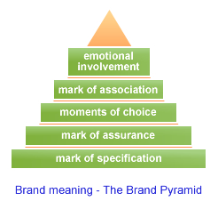

Slide 11
Brands as relationships
Ultimately the brand reflects a relationship between the buyer and the product bought / the supplier. This relationship is based on trust, the fulfilment of promises and common values.
The brand relationship changes as needs change. Buyers can change interests, become bored with their habits. Brands on the other hand can stagnate and wither, or become focused on new customers, or change in their essence.

Slide 12
Price
Price is an important element of marketing mix.
In an era of globalization, one of the challenges that companies face when selling their products abroad is how to set appropriate prices.
Price of a product cannot be kept same in different regions of world. There are many factors that affect pricing in foreign countries like supply & demand, cost, elasticity of demand, exchange rates, market share etc.

Slide 13
Continued
For pricing, we must know the difference between Fixed & Variable Costs.
Fixed costs are those costs, such as factory rental, capital equipment repayments and permanent staff salaries, which at least in the short or medium term, remain unchanged regardless of the level of output achieved.
Variable costs are those costs, such as raw material purchases, wages and electricity, which vary directly according to the level of output achieved.

Slide 14
Continued
When preparing export prices, the following costs may apply.
Fixed costs;
Shipping ex-factory to port of departure;
Import duty and taxes;
Customs clearance/broker fee;
Ground transportation from port of discharge to warehouse or customer, as appropriate;
Warehousing fees, if applicable;

Slide 15
Continued
Agent's commission or importer's mark-up, as appropriate;
Packaging and labelling to local standards;
Product certification, if required;
Product liability insurance;
Advertising costs;
Promotional costs.

Slide 16
Continued
Cost-plus method:
In the cost-plus method, the manufacturer starts with the domestic manufacturing cost and adds administration, research and development, overhead, freight forwarding, distributor margins, customs charges and profit.
Marginal cost pricing:
It involves basing the price on the variable costs of producing a product, not on the total costs (i.e fixed and variable costs).
Total costs = Fixed costs + variable costs

Slide 17
Continued
Marginal cost pricing should relate only to short-term business aimed at disposing of temporary surpluses following the construction of new plant or a seasonal fall-off in other orders.
Apart from the obvious disadvantage of lower profit generation, marginal-cost pricing may also be viewed by the government as dumping.

Slide 18
Distribution (Place)
Distribution is all about getting your products/services to the right people at the right time with special consideration for profit and effectiveness. Successful marketing does not end with developing a product/service and finding its appropriate target audience with a view to selling it at the 'right price'. Another issue of importance is how manufacturers are going to distribute and sell these products/services to the consumers.
When a product/service is purchased by a consumer, it may have been bought directly from the business itself, or it may have been bought through a number of intermediaries (wholesaler, retailer, etc). These are known as distribution channels.

Slide 19
Distribution Strategy
A distribution strategy defines how you are going to move products from point of creation to points of consumption in an efficient and cost-effective manner.” “A distribution strategy also defines how you are going to develop and maintain customer loyalty.”
A distribution strategy must be in sync with how customers want to shop and buy. Today's customers shop and buy very differently than ever before. Their access to high-quality information via the internet, combined with their heightened price sensitivity, have created customers who are more sophisticated, better informed than customers of the past. This new breed of customers no longer plays by the rules of traditional distribution channels.

Slide 20
Continued
Building the right distribution for your company is extremely important, but often underestimated. While most American companies focus 20 % on product and 80 % on distribution’, many European companies have a tendency of doing the opposite.
It doesn’t help to have ‘the best product in the world’ if you don’t know how to get it off the shelf.

Slide 22
Promotion
Promotion plays a vital role in providing information of the product to the customers. It also creates desirability of the product among potential buyers.
Promotion is more culture bound than other P’s of marketing. Hence international companies must take special care in promoting the product in the host / foreign country.
To drive home the message that making cake with its cake mix is a very easy task, a foreign company advertised in Japan that making cake was as easy as cooking rice. The Japanese housewives who had a feeling that cooking rice was a skilled task, got agitated by this. This shows how cultural factors make promotion a delicate task.
The promotion mix includes – Advertising, Personal Selling, Sales Promotion & Public Relations.

Slide 23
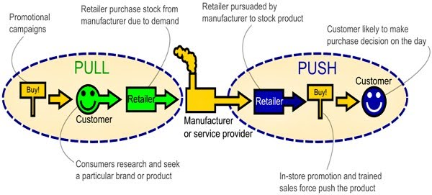

Slide 24
Market Segmentation
It helps to enter the markets in a phased manner. Can be done based on regions, product quality, propensity to buy, age group, cultural aspects etc.
Companies adopt different marketing strategies like product design, pricing strategies, promotion, distribution channels for different market segments in order to maximize sales & profits in each segment.

Slide 25
Targeting in services
Once the firm has identified its market segment, it has to decide how many & which one to target. The firm must look at:
The segment size & growth potential
The segments overall attractiveness & profitability
The company’s objectives & resources
The company can consider five patterns of target market selection:
Single Segment Concentration
Selective Segment Concentration

Slide 26
Continued
Service Specialization Strategy – All available market segments are targeted for a single category of services
Market Specialization Strategy – Only a particular market segment is targeted for all the categories of product & services.
Full market coverage – All the available market segments are targeted for all the category of product & services.
Counter Segmentation: The market & its segments don’t remain static. The difference between the segments may get more insignificant over time & some other segments no longer remain viable. In such a situation, a clubbing of two or more segments is done to have a common strategy of marketing mix. This is counter segmentation.

Slide 27
Product Positioning
It attempts to create an appealing space in a consumer’s mind in relation to the space occupied by competitive products. Foe example Mercedes Benz is positioned for wealthy people, Maruti for middle income group etc.
Dove positioning is consistent over time & across platforms. Has diversified from skin care to hair care to deodorants on soft / smooth platform & the fact that it contains moisturising milk. Its deodorant are positioned as leaving the underarms feeling soft & smooth.

Slide 28
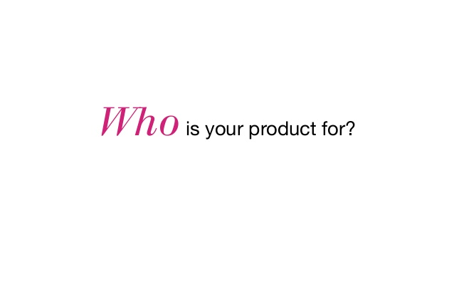

Slide 29
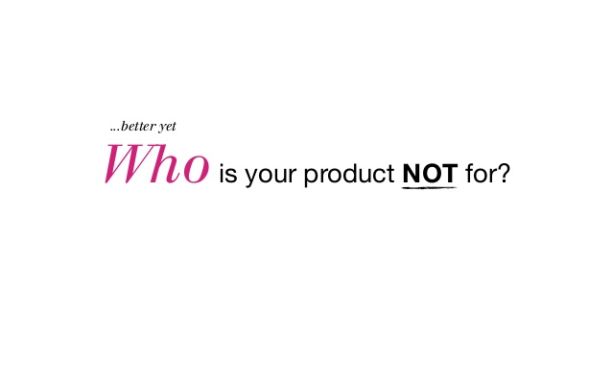

Slide 30
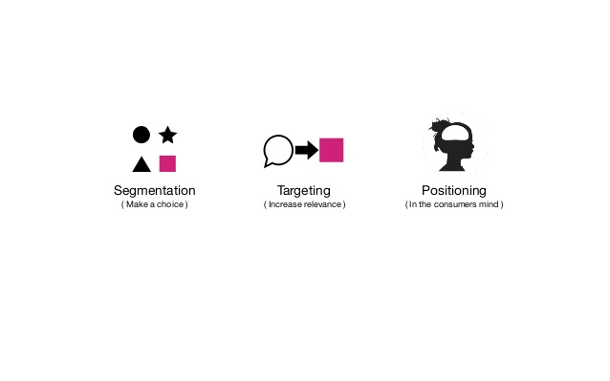

Slide 31


Slide 32
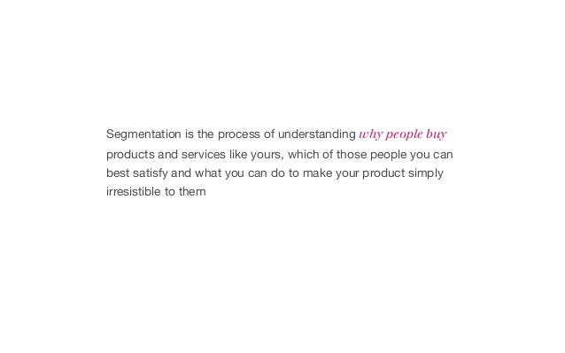

Slide 33
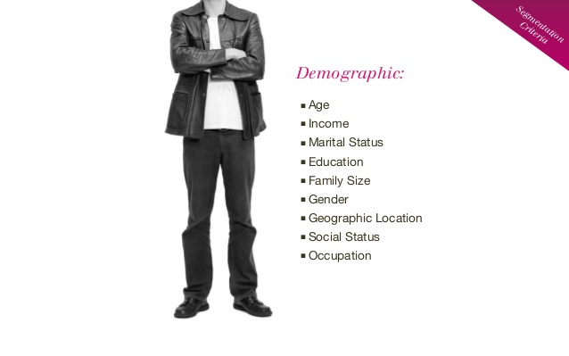

Slide 34
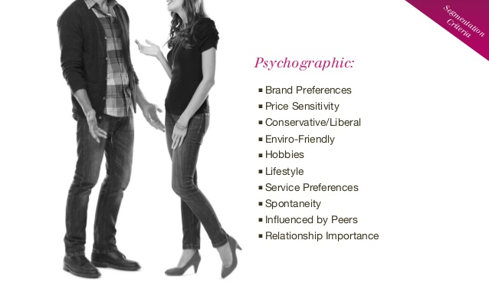

Slide 35
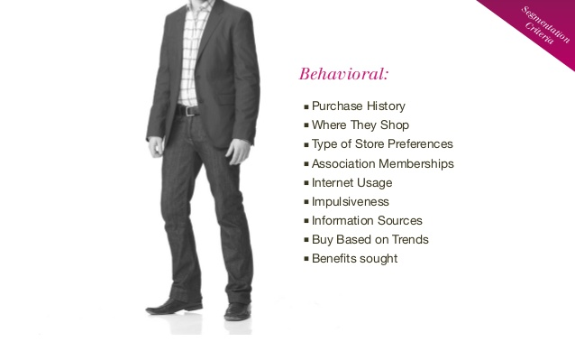

Slide 36
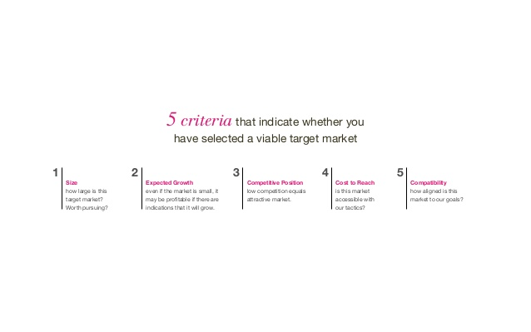

Slide 37
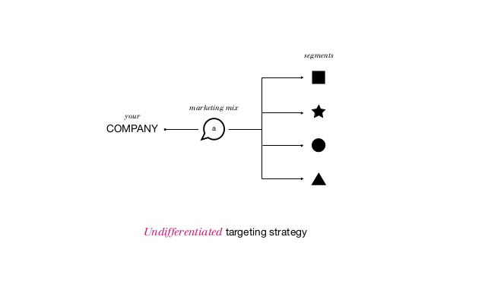

Slide 38
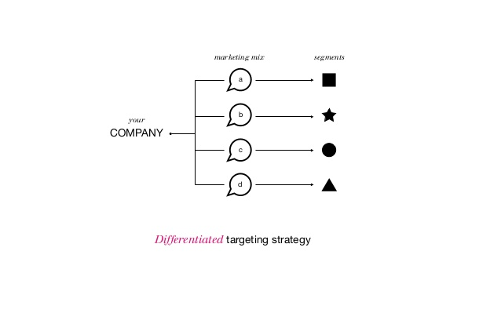

Slide 39
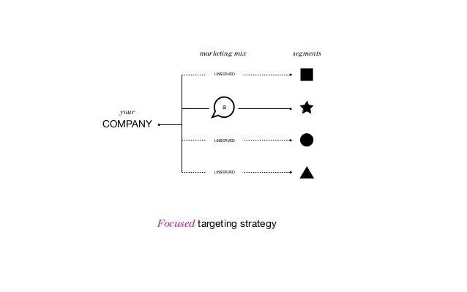

Slide 40


Slide 41
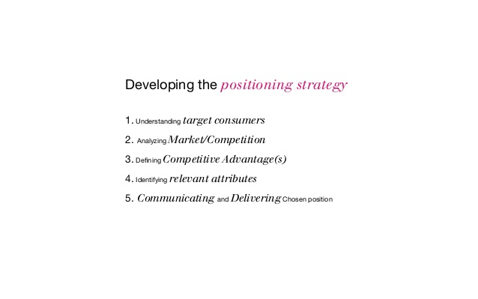

Slide 42
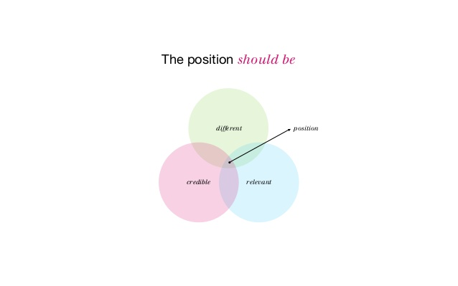

Slide 43
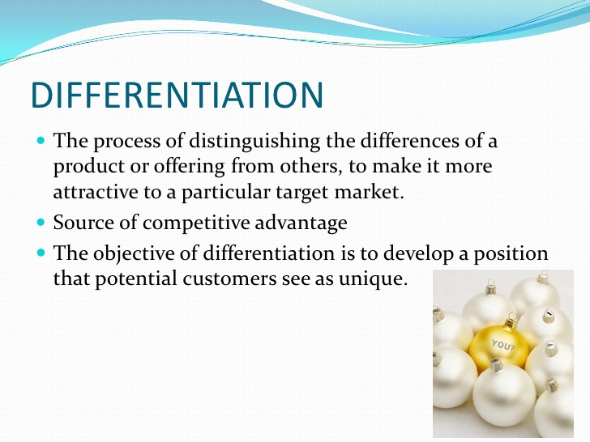

Slide 44
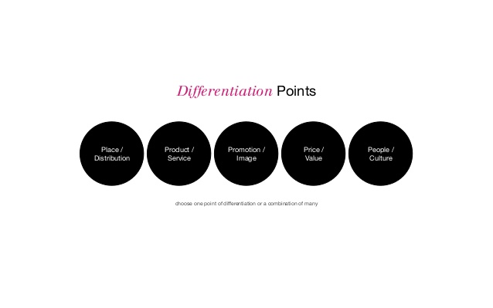

Slide 45
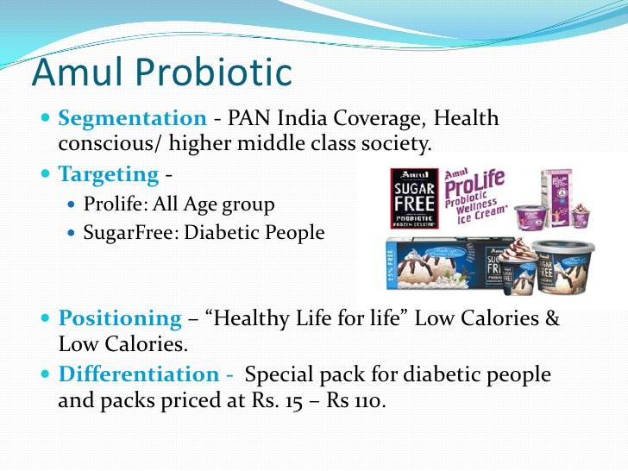

Slide 46
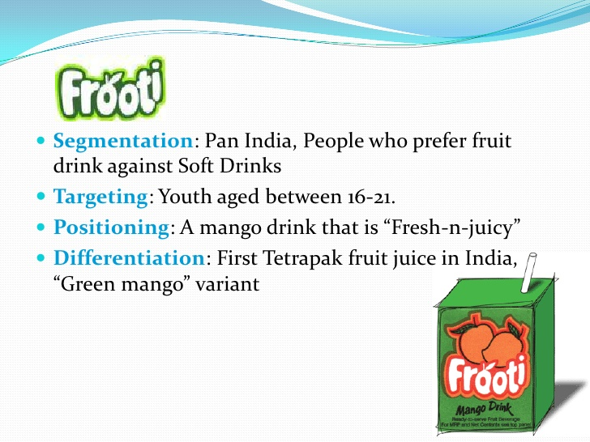

Slide 47
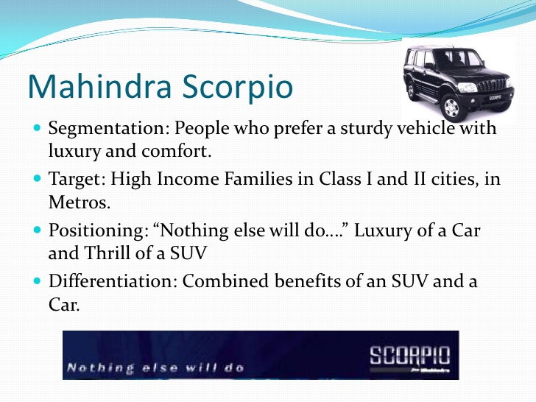

Slide 48
Packaging & Labelling Decisions
The package may include up to three levels of materials. E.g. Old spice aftershave
Bottle - primary package
Cardboard box - secondary package
Corrugated box - shipping package
Packaging serves the following functions:
Protecting the product – Packaging protects the product at minimum cost. If the product is exported, extra protection is needed due to time, distance, varying environmental & climatic conditions etc.
Promotion – Packaging is also used to promote a product. Avon uses crystalline glass for packaging to meet the Japanese preference for beautiful packaging.

Slide 49
Continued
Barrier protection – A barrier from oxygen, water vapour, dust, etc., is often required. Some packages contain oxygen absorbers to help extend shelf life. Controlled atmospheres are also maintained in some food packages.
Portion control – Single serving or single dosage packaging has a precise amount of contents to control usage. Bulk commodities (such as salt) can be divided into packages that are a more suitable size for individual households. It also aids the control of inventory.

Slide 50
Continued
Containment or agglomeration – Small objects are typically grouped together in one package for reasons of efficiency. For example, a single box of 1000 pencils requires less physical handling than 1000 single pencils.
Information transmission – Packages and labels communicate how to use, transport, recycle, or dispose of the package or product. Most items include their serial and lot numbers on the packaging, and in the case of food products, medicine, and some chemicals the packaging often contains an expiry date.

Slide 51
Continued
Security - Packages can be engineered to help reduce the risks of package pilferage or the theft and resale of products. Duplicate goods, unauthorized sales (diversion), material substitution and tampering can all be prevented with these anti-counterfeiting technologies.
Convenience – Packages can have features that add convenience in distribution, handling, stacking, display, sale, opening, reclosing, use, dispensing, reuse, recycling, and ease of disposal.

Slide 52


Continued
Handling Needs - Shipments of Hazardous goods have special information and symbols (labels, placards, etc.) as required by UN, country, and specific carrier requirements. With transport packages, standardized symbols are also used to communicate handling needs.

Slide 53
Not all firms occupy the same position in the total market. Positions of the firms vary in terms of market share they occupy. Depending on their market shares, some are called market leaders - the firms with the largest market shares, others are market challengers - firms fighting hard to increase their market shares and trying to catch the leader’s position, another group is called market followers - firms closed to challengers with respect to market shares and willing to maintain their market shares, yet the other group is market nichers - firms that serve small market segments not served by the larger firms. As their positions vary, the strategies they pursue also vary.

Slide 54
Blue Ocean Strategy
Blue Ocean Strategy is a strategic business framework in which companies achieve superior market positions by creating new and uncontested market spaces instead of competing in existing and competition-saturated markets .
Some businesses achieve dominance by avoiding the “red oceans” of direct competition and fierce rivalry. Instead, they aim to carve out new and uncontested market space, often attracting new customers beyond the boundaries of their own industries.
The key principle here is “value innovation. ”

Slide 55
Examples Of Blue Ocean Strategy
Uber denied competing with taxi companies and developed an app that instantly connects customers and drivers.
iTunes
In 2003, Apple uncovered a vast, blue ocean market for digital music providing free, convenient, and legal song downloads in iTunes.
Furthermore, it allowed users to purchase individual songs for affordable prices. Previously, they had to buy a whole CD if they wanted only one or two pieces. Now iTunes has 99 million subscribers worldwide, having implemented the best of a blue ocean strategy.

Slide 56
Digital & Social Media Marketing
Facebook
Instragram.
Twitter (X)
Linkedin
YouTube
Blogging.

Slide 57
Difference Between Home & Host Country
Home Country – The country to which the domestic company belongs. For example the home country for Unilever is U.K. where it is headquartered.
Host Country – The foreign country in which the domestic company markets, manufactures or has a subsidiary. The host country for Unilever are Australia, Pakistan, India etc.

Slide 58
International Business Approaches / Orientation ( EPRG Orientation)
Ethnocentric Approach - Company formulates policies for the domestic market and extends the same product / strategies to the International market. Suitable for companies during early days of Internationalisation & for smaller companies. Risk is minimum.
Polycentric Approach – Companies later realize that the foreign markets need an altogether different approach. It establishes a foreign subsidiary & decentralises decision-making authority to the subsidiary.

Slide 59
Continued
Regio-centric Approach – The company after operating successfully in
a foreign country thinks of exporting to the neighbouring countries
of the host country. The foreign subsidiary considers the regional
environment for formulating policies & strategies. It markets more
or less the same product designed under polycentric approach in
other countries of the region but with different marketing strategies.
Example Unilever has its subsidiary – Unilever India which
manufactures in India & markets the same product in Bangladesh,
Sri – Lanka etc.

Slide 60
Continued
Geocentric Approach – The entire world is like a single country for the company. It operates with a no. of subsidiaries. The HQ coordinates the activities of the subsidiaries. The operations are integrated & the subsidiaries gain from each other’s experience.

Slide 61
Motives of Internationalization of Firms
1) Profit Advantage : IB could be more profitable than domestic
business. Also the total Profit increases & thus it becomes
profitable.
2) Growth Opportunities: To increase sales , To increase market
share , expand production capacity beyond the domestic
demand.
3) Competition: Increased competition in domestic market is one of the main
cause & consequences of globalization.

Slide 62
Continued:
4) Domestic market constraints: Includes factors like Surplus production in
home market, decline in the demand of product in the home market, small
domestic market size or limited home market, product reaches maturity
stage in home country.
5) Economies Of Scale: Greater the size of business, greater will be the
economies of scales.
6) High Cost Of Transportation: Foreign companies are inclined to increase their
profit margins by locating their manufacturing facilities in foreign countries
where there is enough demand either in one country or in group of
neighbouring countries.

Slide 63
Continued
7) Political Stability Vs. Political Instability : Political stability does not
simply mean continuation of the same party in power. It means
continuation of the same policies. U.S.A., U.K., Japan, France,
Germany are considered politically stable.
8) Availability of Technology & Competent Human Resources :
American & European countries depend on Indian companies for
software products & services through BPO’s & KPO’s.

Slide 64
Continued
9) Nearness To Raw Materials : Foreign companies locate their
manufacturing units closer to the source of raw materials to get
quick & timely supplies & save on transportation cost.
10) Availability of Quality Human Resources at less cost: Major factor
for software, high technology & telecommunication company’s to
locate their operations in India. Importing HR from India by U.S.A. ,
Europe etc. is costly than locating their operations in India.
11) Achieve Higher Rate Of Economic Development.

Slide 65
Factors affecting International Pricing
Below are some important factors affecting international pricing:
Cost of production
Cost of product or service is an important base of pricing decision. Total cost includes cost of raw materials, cost of labour, transportation cost, fixed cost, variables cost etc. For short term, company may ignore the recovery of cost in order to capture maximum market share.

Slide 66
Continued
Trade cycle
During the boom cycle of market, there will be rise in price. But in case of global recession, there will be trend of decreasing price.
Marketing objectives of the company
Marketing goals and objectives also have impact on product pricing. Like if the objective is to target niche marketing, where the company selects a small market segment with minimum competition, its best suited for high price. And if the objective is mass marketing to capture maximum market share, the company will set lower price of its products and services.

Slide 67
Continued
Competition
In case of monopoly or less competition, international company can set high price. But in case of intense competition, company will set lower price. Global companies fixes prices not only based on cost but also based on competitor’s pricing.
Product substitution
Non-availability of substitute product will lead to high price. But if there are better and cheaper substitute products, company will be forced to keep lower price.

Slide 68
Continued
Brand image
In case of good image, company can set high price for its products and services. Like Apple Inc. keeps high price of its electronics products (ipod, iphone etc) because of its very high brand image.
Elasticity of demand
In case of perfectly inelastic demand, the firm may set higher price. But when demand is highly elastic, price will be low.
Tariffs & Distribution costs
Tariffs are in the form of Duties and taxes. Tariffs can also be in the form of trade barriers. While pricing a product, the taxes and duties are taken into account.

Slide 69
Continued
Stage of product life cycle
Price of product also depend on its stage in life cycle. Price of a product is different during different stage of product life cycle. Like, in growth stage, price will be high while in decline stage price will be low.
Capacity utilization ratio
Every manufacturing plant has its own installed capacity, means maximum capacity to produce the products. International company having high capacity utilization ratio can keep the price very competitive because of its low fixed cost.

Slide 70
Continued
Product differentiation
If the company can strongly differentiate its products from the competitor’s product, then it can set high price.
Consumer profile / Economic Conditions of the importing country.
Consumer profile includes education level, income, life style, attitude etc. Price of many products in USA can be set high. But company cannot set high price in poor and undeveloped countries.

Slide 71
Continued
Exchange rate
Different currency have different value at different time. Due to discrepancies in the value of different currency, similar products in different countries may be priced differently. Products manufactured in developing countries & marketed in advanced countries can be priced high to the advantage of foreign exchange. Market Size
A company will often attempt to use the potential volume of sales to estimate the price at which they will need to market their product to break even. For larger countries with the potential for more sales, this price may be set lower; for smaller countries, the price may be higher.

Slide 72
Continued
Cultural Differences
Cultural variations that affect pricing can take many forms - how members of certain cultures perceive the value of certain products, affects how much they are willing to pay for them. For example, in the United States women's handbags are often seen as a status symbol. Female consumers, therefore are willing to pay high prices. In other cultures, however, handbags are considered more functional, meaning they can only command a significantly lower price.

Slide 73
Continued
Government Factors
When setting prices, companies must research all national regulations relevant to their product. Many countries set price ceilings as well as price floors on certain products. For example, in Nigeria (a large oil producer) the price of gasoline and other petroleum derivatives is capped. Regulations placed on the prices of similar products may affect potential demand and thus price. The government provides subsidies, tax concessions for manufacturing certain products, encouragement to local exporters through finance, inputs at lower indexes etc.

Slide 74
Modes Of Entry
Companies select different modes to enter a foreign country based on factors like the size of business, influence of environmental factors, attractiveness of foreign market, market potential, cost & benefit analysis, risks factors etc.
The various modes of entry are:
Exporting – It is widely used mode of entry as the need for finances & risk exposure is minimum. There are 3 form’s of exporting.

Slide 75
Exporting
Indirect Exporting
Export merchants
Export agents
Export management companies (EMC)
Direct Exporting
Firms set up their own exporting departments
Intra-Corporate Transfers

Slide 76
Licensing
The domestic manufacturer leases the right to use its intellectual property i.e. technology, work methods, patents, copy rights, brand names, trade marks etc. to a manufacturer in a foreign country for a fee. The manufacturer in the domestic country is a “licensor” & the manufacturer in a foreign country is a “licensee.”
The domestic company can choose any international location & enjoy the advantages without incurring any obligations & responsibilities of ownership, investment etc.

Slide 77
Franchising
It is a form of licensing.
Franchisor can exercise more control over the franchisee compared to that in licensing.
Franchisor provides the following services to the franchisee – trade marks, operating systems, support systems like employee training, quality assurance programme, advertising etc.
Franchisee pays a fee to the franchisor.

Slide 78
Special Modes Of Entry
Contract Manufacturing – Some companies outsource their part or entire production & concentrate on marketing operations. For Example Nike, Bata etc.
Advantages :
Companies can focus on part of the value chain where it has distinctive advantage.
It reduces cost of production as the host countries companies with their relative cost advantage produce at low cost.
SME’s in host country can also develop as they are engaged in contract manufacturing.

Slide 79
Continued
Disadvantages Of Contract Manufacturing
Host country’s companies can take up marketing activities too.
Host country companies may not strictly adhere to the designs, quality etc.
The poor working conditions in host country’s companies affect the company’s image.

Slide 80
Continued
Turnkey Projects – It is a contact under which a firm agrees to fully design, construct & equip a manufacturing / business facility & turn the project over to the purchaser when it is ready for operation for a remuneration. Example Indonesian government tender for construction of sugar factory.
International turnkey projects include nuclear power plants, airports, oil refineries etc. Recent approach B-O-T.
They require huge finances & companies normally approach host country’s government, Export – Import bank of U.S.A. etc. for financial assistance.

Slide 81
FDI without Alliance
Companies which enter the international markets through FDI invest their money, establish manufacturing & marketing facilities through ownership & control.
Advantages
Customers of some companies prefer products manufactured in their country. FDI helps the company to gain market through this mode.
Purchase manager of most of the company’s prefer to buy local production in order to ensure certainty of supply, faster service, quality dependability & better communication with the supplier.
The company can produce based on the local environment & changing preferences of the customers.

Slide 82
FDI with Strategic Alliance
Strategic alliance is a co-operative & collaborative approach to achieve larger goals.
Innovations, creations, productivity, growth, expansions & diversifications are mostly accompanied by strategic alliance like mergers, acquisitions & joint – ventures.
Alliance is a strategy to explore a new market which companies individually cannot do.
Two companies join hands in order to align their distinctive & different strengths. Dunlop & Pirelli joined hands to synergise the strength of marketing capabilities of Dunlop & R&D capabilities of Pirelli.

Slide 83
THANK YOU

